Slide 1
Medium Access Control (MAC)

Slide 2
Media Access Control (MAC)
The Media Access Control (MAC) data communication protocol sub-layer, also known as the Medium Access Control, is a sub layer of the Data Link Layer specified in the seven layered OSI model (layer 2).
The hardware that implements the MAC is referred to as a Medium Access Controller.
The MAC sub-layer acts as an interface between the Logical Link Control (LLC) sublayer and the network's physical layer.

Slide 3
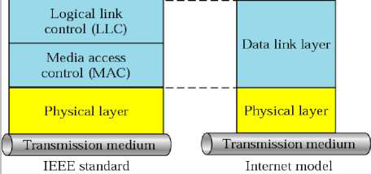

Slide 4
Motivation for a specialized MAC
One of the most commonly used MAC schemes for wired networks is carrier sense multiple access with collision detection (CSMA/CD). In this scheme, a
sender senses the medium (a wire or coaxial cable) to see if it is free. If the medium is busy, the sender waits until it is free. If the medium is free, the sender starts
transmitting data and continues to listen into the medium. If the sender detects a collision while sending, it stops at once and sends a jamming signal.
But this scheme doest work well with wireless networks.

Slide 5
Motivation for a specialized MAC
The problems are:
Signal strength decreases proportional to the square of the distance
The sender would apply CS and CD, but the collisions happen at the receiver
It might be a case that a sender cannot “hear” the collision, i.e., CD does not work
Furthermore, CS might not work, if for e.g., a terminal is “hidden”

Slide 6
Motivation for a specialized MAC
Hidden and Exposed Terminal
Consider the scenario with three mobile phones as shown below. The transmission range of A reaches B, but not C (the detection range does not reach C either). The transmission range of C reaches B, but not A. Finally, the transmission range of B reaches A and C, i.e., A cannot detect C and vice versa.

Slide 7
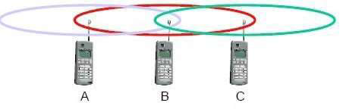

Slide 8
Hidden and Exposed terminals
Hidden terminals
A sends to B, C cannot hear A
C wants to send to B, C senses a “free” medium (CS fails) and starts transmitting
Collision at B occurs, A cannot detect this collision (CD fails) and continues with its transmission to B
A is “hidden” from C and vice versa.
Exposed terminals
B sends to A, C wants to send to another terminal (not A or B) outside the range
C senses the carrier and detects that the carrier is busy.
C postpones its transmission until it detects the medium as being idle again
but A is outside radio range of C, waiting is not necessary
C is “exposed” to B
Hidden terminals cause collisions, where as Exposed terminals causes unnecessary delay.

Slide 9
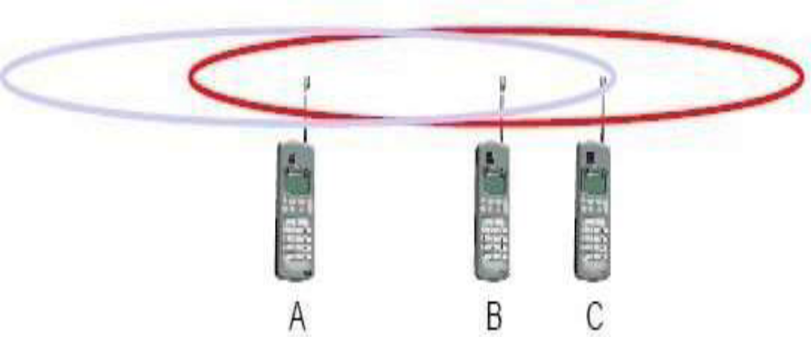
Near and far terminals
Consider the situation shown below.
A and B are both sending with the same transmission power.

Slide 10
Near and far terminals
Signal strength decreases proportional to the square of the distance.
So, B’s signal drowns out A’s signal, making C unable to receive A’s transmission
If C is an arbiter for sending rights, B drown out A’s signal on the physical layer making C unable to hear out A.
The near/far effect is a severe problem of wireless networks using CDM. All signals should arrive at the receiver with more or less the same strength for which Precise power control is to be implemented.

Slide 11
A cellular system divides any given area into cells where a mobile unit in each cell communicates with a base station.
The main aim in the cellular system design is to be able to increase the capacity of the channel i.e. to handle as many calls as possible in a given bandwidth with a sufficient level of quality of service.

Slide 12
MAC for wireless communications
There are several different ways to allow access to the channel.
These includes mainly the following:
1) Frequency division multiple-access (FDMA)
2) Time division multiple-access (TDMA)
3) Space Division Multiple access (SDMA)
4)Code division multiple-access (CDMA)

Slide 13
MAC for wireless communications
FDMA,TDMA and CDMA are the three major multiple access techniques that are used to share the available bandwidth in a wireless communication system.
Depending on how the available bandwidth is allocated to the users these techniques can be classified as narrowband and wideband systems.

Slide 14
Narrowband Systems
The term narrowband is used to relate the bandwidth of the single channel to the expected coherence bandwidth of the channel.
The available spectrum is divided into a large number of narrowband channels. The channels are operated using FDD.
In narrow band FDMA, a user is assigned a particular channel which is not shared by other users in the vicinity and if FDD is used then the system is called FDMA/FDD.

Slide 15
Narrowband Systems
Narrow band TDMA allows users to use the same channel but allocates a unique time slot to each user on the channel, thus separating a small number of users in time on a single channel.
For narrow band TDMA, there generally are a large number of channels allocated using either FDD or TDD, each channel is shared using TDMA.
Such systems are called TDMA/FDD and TDMA/TDD access systems.

Slide 16
Wideband Systems
In wideband systems, the transmission bandwidth of a single channel is much larger than the coherence bandwidth of the channel.
Thus, multipath fading doe’snt greatly affect the received signal within a wideband channel, and frequency selective fades occur only in a small fraction of the signal bandwidth

Slide 17
Frequency Division Multiple Access
This was the initial multiple-access technique for cellular systems in which each individual user is assigned a pair of frequencies while making or receiving a call.
One frequency is used for downlink and one pair for uplink. This is called frequency division duplexing (FDD).
That allocated frequency pair is not used in the same cell or adjacent cells during the call so as to reduce the co channel interference.
The FDMA channel carries only one phone circuit at a time. If an FDMA channel is not in use, then it sits idle and it cannot be used by other users to increase share capacity.

Slide 18
Frequency Division Multiple Access
The bandwidths of FDMA systems are generally narrow i.e. FDMA is usually implemented in a narrow band system.
The complexity of the FDMA mobile systems is lower than that of TDMA mobile systems.
FDMA requires tight filtering to minimize the adjacent channel interference.

Slide 19
SDMA
Space Division Multiple Access (SDMA) is used for allocating a separated space to users in wireless networks.
A typical application involves assigning an optimal base station to a mobile phone user. The mobile phone may receive several base stations with different quality.
A MAC algorithm could now decide which base station is best, taking into account which frequencies (FDM), time slots (TDM) or code (CDM) are still available.
The basis for the SDMA algorithm is formed by cells and sectorized antennas which constitute the infrastructure implementing space division multiplexing (SDM).

Slide 20
It is usually combined with other multiplexing techniques to better utilize the individual physical channels.
Time Division Multiple Access
In digital systems, continuous transmission is not required because users do not use the allotted bandwidth all the time.
In such cases, TDMA is a complimentary access technique to FDMA.
Global Systems for Mobile communications (GSM) uses
the TDMA technique.

Slide 21
Time Division Multiple Access
In TDMA, the entire bandwidth is available to the user but only for a finite period of time.
TDMA requires careful time synchronization since users share the bandwidth in the frequency domain.
The number of channels are less, inter channel interference is almost negligible.
TDMA uses different time slots for transmission and reception.
This type of duplexing is referred to as Time division duplexing(TDD).

Slide 22
The features of TDMA includes the following:
TDMA shares a single carrier frequency with several users where each users makes use of non overlapping time slots.
The number of time slots per frame depends on several factors such as modulation technique, available bandwidth etc. Data transmission in TDMA is not continuous but occurs in bursts.
This results in low battery consumption since the subscriber transmitter can be turned OFF when not in use.
Because of a discontinuous transmission in TDMA the handoff process is much simpler for a subscriber unit, since it is able to listen to other base stations during idle time slots.

Slide 23
Code Division Multiple Access
In CDMA, the same bandwidth is occupied by all the users, however they are all assigned separate codes, which differentiates them from each other.
CDMA utilize a spread spectrum technique in which a spreading signal is used to spread the narrow band message signal.

Slide 24
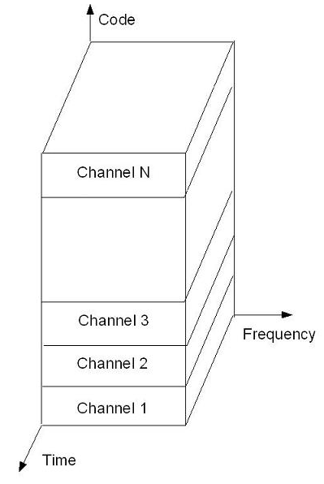
Code Division Multiple Access
CDMA/FDD in IS-95
In this standard, the frequency range is: 869-894 MHz (for Rx) and 824-849 MHz (for Tx).
In such a system, there are a total of 20 channels and 798 users per channel.

Slide 25
Code Division Multiple Access
The near-far problem is a serious one in CDMA.
This problem arises from the fact that signals closer to the receiver of interest are received with smaller attenuation
than are signals located further away.
Therefore the strong signal from the nearby transmitter will mask the weak signal from the remote transmitter.

Slide 26
Compare TDMA, CDMA, FDMA and SDMA
Approach | SDMA | TDMA | FDMA | CDMA
Idea | Segment spaced into cells or sectors. | Segments sending time into disjoint time slots demand driven or fixed patterns. | Segment the frequency band into disjoint subbands | Spread the spectrum using orthogonal codes.
Terminals | Only one terminal can be active in one cell or one sector. | All terminals are active for short periods of time on same frequency. | Every terminal has its own frequency uninterrupted | All terminals can be active at the same place at the same moment uninterrupted.
Signal separation | Cell structure, directed antennas | Synchronization in time domain | Filtering in the frequency domain. | Code plus special receivers.
Transmission scheme | Continuous | Discontinuous | Continuous | Continuous
Cell capacity | Depends on cell area | Limited | Limited | No absolute limit on channel capacity but it is an interference limited system
Advantages | Very simple, increases capacity per | Established fully digital, flexible | Simple, established, robust | Flexible, less frequency planning needed, soft handover
Disadvantages | Inflexible, antennas typically fixed | Guard space needed (multipath propagation), synchronization difficult | Inflexible, frequencies are scarce resource | Complex receivers, needs more complicated power control for senders
Comment | Only in combination with TDMA, FDMA or CDMA useful | Standards in fixed networks, together with FDMA or SDMA used in many mobile networks | Typically combined with TDMA and SDMA | Still faces some problems, higher complexity, lowered expectations, will be integrated with TDMA or FDMA

